Slide 1
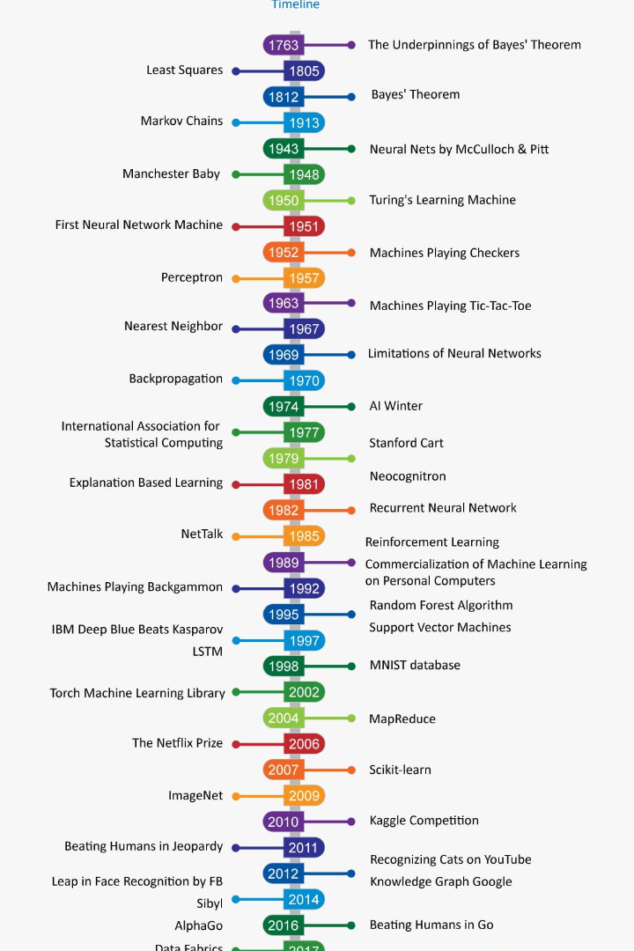

Setting Up a Data Science Team
Guide for creating a successful data team, from team structures to salary ranges to computing infrastructure
by Deepak Mishra

Slide 2
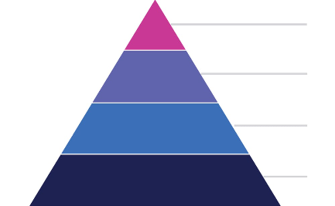

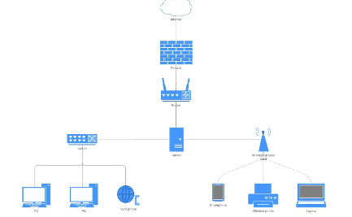
Team Structures
Top-Down Hierarchy
Cross-Functional Teams
Decentralized Teams
A more traditional team structure with clearly defined job roles and a top-down approach to decision-making.
A team structure that breaks down silos and encourages expertise-sharing across various departments and functions.
A decentralized team structure that operates remotely and is free to pursue individual project goals.

Slide 3
Advantages and Disadvantages of Different Team Structures and Infrastructure Options
1
Centralized Team
Pros: Strong cohesion, unified communication, easier to manage.
Cons: Less adaptability, lower specialization, may create bottlenecks
Hub and Spoke
2
Pros: More flexibility, higher specialization, better suited to large organizations.
Cons: May lead to confusion among internal stakeholders, may lead to fragmentation
3
Cloud Computing
Pros: Scalable, cost-effective, easy to manage.
Cons: Relies on internet connection, may lack full control over the computing environment.
In-House Computing
4
Pros: Customized, greater control, higher security.
Cons: More maintenance, less scalable, requires higher investment overheads.

Slide 4

Job Roles
1
Data Analysts
2
Data Scientists
Responsible for analyzing large sets of data, generating insights, and providing data-driven recommendations to inform business decisions.
Use machine learning and statistical models to build predictive models and generate insights that can drive innovation and growth.
3
Data Engineers
4
Data Visualization Experts
Responsible for managing databases and data pipelines, ensuring data availability and integrity, and developing scalable and efficient systems to support data-driven initiatives.
Specialists in creating compelling visualizations and engaging dashboards to deliver insights in a clear and concise manner.

Slide 5
Job Roles in Data Science Team
Data Scientist
Data Engineer
Data Analyst
Machine Learning
Hadoop, Spark
Data cleaning, wrangling, and munging
Data visualization
Experience in ETL processes
Deep learning
SQL, Excel
Python, R
3-5 years of experience
1-3 years of experience
3-6 years of experience
$90,000-$150,000 salary range
$50,000-$90,000 salary range
$70,000-$130,000 salary range
Implementing data pipelines and optimizing data warehouse systems
Creating reports and visualizations
Developing predictive models and algorithms

Slide 6
Skillsets
1
Programming Languages
Python, SQL, Spark
Machine Learning
2
Classification, Regression, Clustering, Deep Learning
3
Statistics
Hypothesis Testing, Regression Analysis
Big Data Technologies
4
Hadoop, Spark, NoSQL Databases

Slide 7
Salary Range
Entry-Level
Mid-Level
Senior-Level
$50,000-$70,000
$80,000-$120,000
$120,000-$200,000+

Slide 8
Tools
Programming Languages
Python, R, SQL
Visualization Tools
Tableau, Power BI, D3.js
Big Data Technologies
Hadoop, Spark, Cassandra
Cloud Platforms
AWS, GCP, Azure

Slide 9
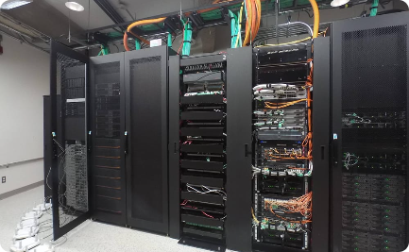


Computing Infrastructure
On-Premises Infrastructure
Cloud Infrastructure
Hybrid Infrastructure
Cloud computing provides flexibility and scalability, as well as cost savings and easier access to cutting-edge tools and technologies.
A mix of on-premises and cloud infrastructure that offers the best of both worlds, with higher security and lower costs.
Traditional on-premises infrastructure offers maximum control and security but requires significant investment and maintenance.

Slide 10
Success Stories
1
Customer Insights
Used data science to identify high-value customers and offer targeted discounts, resulting in a 10% increase in customer retention and a 30% increase in revenue.
Applied Machine Learning
2
Used machine learning to personalize the user experience and provide tailored recommendations, resulting in a 60% increase in user engagement and a 25% reduction in subscription churn.
3
Cost Optimisation
Used predictive analytics to optimize inventory management and reduce waste, resulting in a 50% reduction in out-of-stock products and a $2 billion increase in revenue.

